Slide 1

3D Game Development Session 3 – Events, Raycasts & Interfaces
ICTGAM423 | ICTGAM427 | ICTGAM430​
SMTAFE Thornlie | Semester 2 2023​
Ian Bell | ian.bell@smtafe.wa.edu.au​

Slide 2
Today:
Updating SuperSoccer
Improved Input system for the player controller
Improved movement system for the player
Improved system for detecting ball collision
Adding a main menu & score display to SuperSoccer
Updating the ‘score’ using Events
Changing the scene using Events
Raycasting in Unity
Updating ‘SuperSoccer’ to include a kick function
Pathfinding: creating Pseudocode for a Bread-First Search

Slide 3

Depth First Search Pseudocode

Slide 4
BFS – the Basic premise
Algorithm will use a ‘queue’
First in, first out processing
Beginning with the ‘origin’ or starting node as ‘current node’:
Check if current node is the target; continue if it isn’t, return path if it is
Find the neigbours of ‘current’ node
Add neighbours to stack if they are not in stack or already searched
Select the node at the top of the stack
Assign current node as ‘parent’ of the selected node
Set selected node to ‘current node’
Go back to start

Slide 5
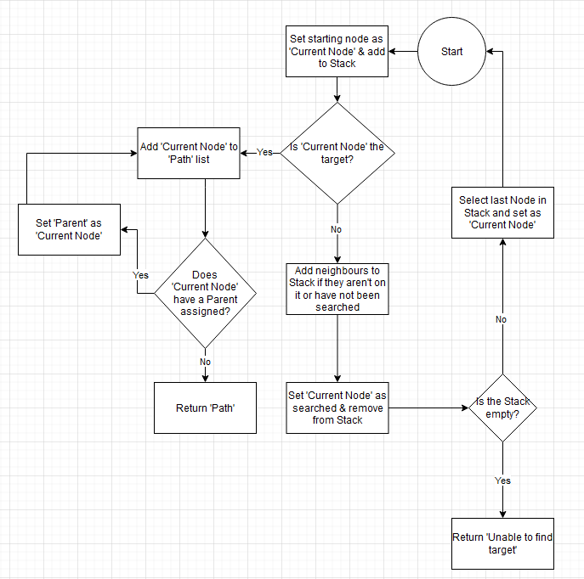
BFS - Flowchart
We can lay out our logical flow with a chart built in diagrams.net
You could also hand draw, use PhotoShop, GIMP or even MSPaint

Slide 6
BFS – Identifying Required Classes/Components
In order to implement the desired functionality we would need two classes…
We need to the able to track different parameters on individual nodes
Accordingly, we’d need a Node class attached to each node
We also need a script which actually contains the algorithm and performs the search
This will be BreadthFirstSearch.cs

Slide 7
BFS – Defining Required Classes/Components
Node class
Each ‘node’ will contain unique information via variables
The data can be set within the class via methods and retrieved by other classes
BreadthFirstSearch class
Will contain the code for actually executing the pathfinding
Will contain variables for storing the nodes, starting point, finish point and path (once calculated)

Slide 8
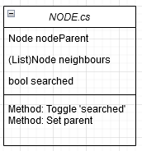
BFS – the Node class
Using diagrams.net we can plan out the classes and their relationships
All nodes within our graph contain variables for
Parent node
A list of neighbouring nodes
A ‘searched’ Boolean
They use the methods
Toggle ‘Searched’
Set/Clear parent

Slide 9
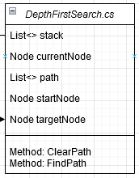
BFS – BreadthFirstSearch.cs Variables
The ‘queue’ = List<T> of Node objects
The <T> is the ‘Type’ for the list and can be a variable or class
The type for this will ideally be the same as the custom script we use for our nodes, ‘Node.cs’
‘Current node’ = Node variable
Any node in our queue List<T> can be set as ‘current node’
Will allow us to perform functions and check variables specifically targeting one node
EG: adding neighbours to the queue

Slide 10
DFS – DepthFirstSearch.cs Variables
‘Path’ to be returned = another List<T> of Node objects
Once the algorithm has ‘located’ the target node, this List is returned as a value
‘starting node’ = Node object
Potentially not actually needed, but will store the identity of the node the pathfinding started from
‘target node’ = Node object
Identifies which node is the end point for the algorithm
Can be used to check if ‘current node’ is the node we are aiming for

Slide 11
BFS – BreadthFirstSearch.cs Methods
ClearPath()
Will remove all objects stored in the ‘path’ List<>
Could be included as part of the main FindPath() method
Creating a separate code block keeps the code neat
ClearPath() could be used for other purposes, potentially
FindPath()
Main implementation of the algorithm
Returns a list of Nodes which will be assigned to Path list
Whenever this method is called it will clear the current path
Will also clear the parent variable on all nodes (could potentially be a separate function)

Slide 12

BFS – Pseudocode time
Start by creating BreadthFirstSearch.cs
What are the variables which we need to track?
Enter them as code comments for now
What will happen when this script is activated?
What happens on Update()?
Add the methods in
Using comments, plan out how each method will work

Slide 13
Questions? Concerns?
With this framework we could begin implementing it
Which objects will actually need to exist in our scene?
What other elements would we need for…
AI who actually use the pathfinding
Setting up the network of nodes automatically
Adding the ability to set nodes as ‘occupied’ or ‘blocked’
Showing a visualization of the path once it’s calculated

